Slide 1




SetScene
IMMERSRE. EXPLORE. CREATE.
Qatar University

Slide 2

PROBLEM
Traditional reading is static and solitary, making it harder to stay engaged in a world filled with interactive media.
Many people struggle to visualize story worlds deeply, which weakens immersion and emotional connection.
Individuals with dyslexia or reading difficulties face barriers when dealing with long text formats, leading to frustration and reduced enjoyment.
Most digital reading tools simply place text on a screen and offer no real enhancement to the reading experience.
There is no major platform that blends literature with interaction, immersion, and a sense of community.

Slide 3

SOLUTION: SetScene
Provide immersive VR environments inspired by books across all genres, allowing users to step directly into story settings.
Create a multisensory reading experience that supports dyslexic readers through visual storytelling, spatial cues, interactive exploration, and optional audio narration.
Increase engagement and enjoyment by transforming stories into interactive spaces filled with atmosphere, discovery, and meaningful interactions.
Welcome all types of readers, including casual readers, passionate book lovers, genre fans, explorers, and neurodiverse users.
Offer social features such as shared virtual libraries, co-exploration, and virtual book clubs that make reading more communal.
Strengthen growth through curated content, partnerships, and an active community.

Slide 4

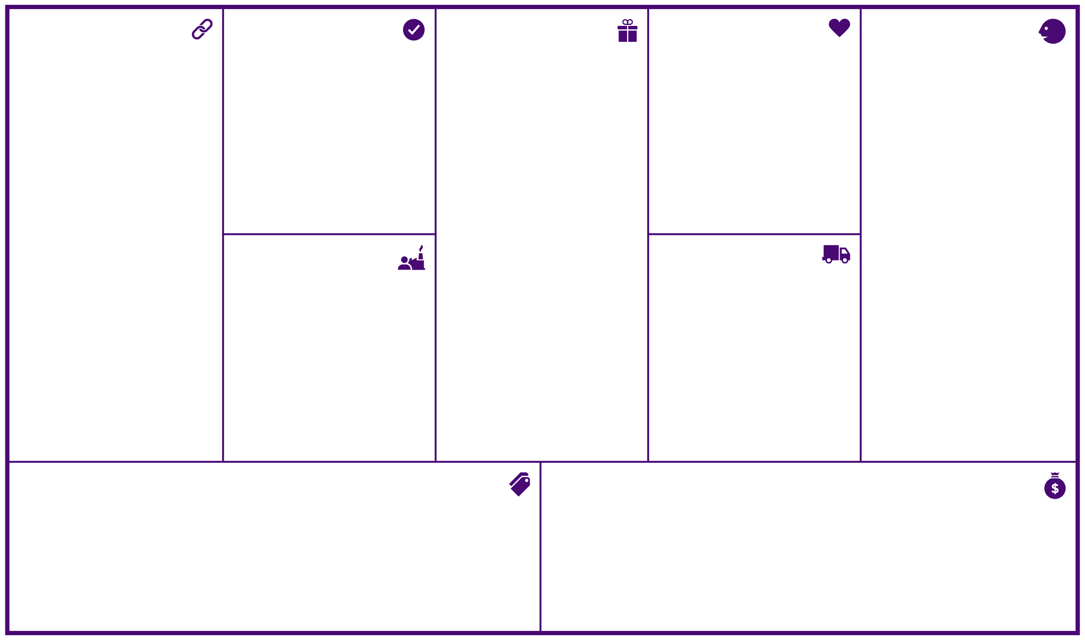

BUSINESS MODEL CANVAS
Key Partners
Key Activities
Value Propositions
Customer Relationships
Customer Segments
Strategic Alliances:
Apple (apple vision) and other VR companies
Amazon (bundles, gift cards)
Disney (story writing)
Authors
Design companies
Competition
Video books production companies
Content acquisition and production
Platform development and maintenance
Data & algorithm management
Marketing & customer acquisition
Partnerships & distribution
Customer support & expertise
for segment 1 (readers):
Vast library of videobooks and visual content
High-quality visuals and scenery
Exclusive member benefits and discounts
Personalized recommendations
User-friendly app and interface
Offline listening
Time-saving entertainment and education
Access to original content
Ensure great user recommendation to retain current customer base
Build and secure a partnership with Studios and content production houses
Comply with the laws (laws as per to State or Region/country), maintaining compliance to censorship, specifically for minors and children
for segment 2:
provide all the help needed to design their own visual books
market for their books and recommend them for customers
for segment 1 (readers):
personal assistance through: Customer support (automated – chatbots/ personal assistant)
self-service: (main service) purchasing and browsing through the app/software on their own
automated service: visual book Recommendation system
communities: Reading discussions
co-creation: book Reviews
for segment 2:
dedicated personal assistance: Authors hunting and maintaining relationships
co-creation: in the creation and design of the scenes
segment 1 (readers):
owners of VR sets
Book readers (of ages 6+)
Visual readers
Dyslexic people
Students
VR owners
segment 2:
Writers
Publishers of Physical Books
Producers of VideoBooks
Key Resources
Channels
Physical (distribution networks)
Intellectual (brand, copyrights)
Human: software developers, dedicated personnel, customer support, marketing, authors, AI engineers, primer graphic designers
Awareness (social media and book influencers)
Evaluation (a pop-up feedback)
Purchase and delivery (app/software)
After sale (chatbots, communities, live chats)
Cost Structure
Revenue Streams
Cost of designing the scenes
Cost of recommendations and AI algorithms
Logistics
Cost of developing the app/software
Infrastructure (data centers) cost of streaming content
Employee salary distribution (customer service, Engineers, etc.)
Cost of producing books and their visuals
revenues from segment 1 (readers):(transaction revenues)
Asset sale: buy books at Fixed menu prices (range based on economy)
revenues from segment 2:(recurring revenues)
usage fees: using the design visuals book services
Ads: to recommend publishers’ books on top

Slide 5
TRACTION (in details coming up)
Prototype Progress
Built VR library, interactive scenes, and themed book environments
Live demo
Social Proof
Early engagement through Instagram: likes, comments, and interest from potential customers within two months
Market Validation
Survey data shows a preference for immersive reading experiences and helps in building the MVP
The feasibility study shows strong potential for the project
Engagement metric from the landing page provides an early perspective into the platform’s potential engagement

Slide 6
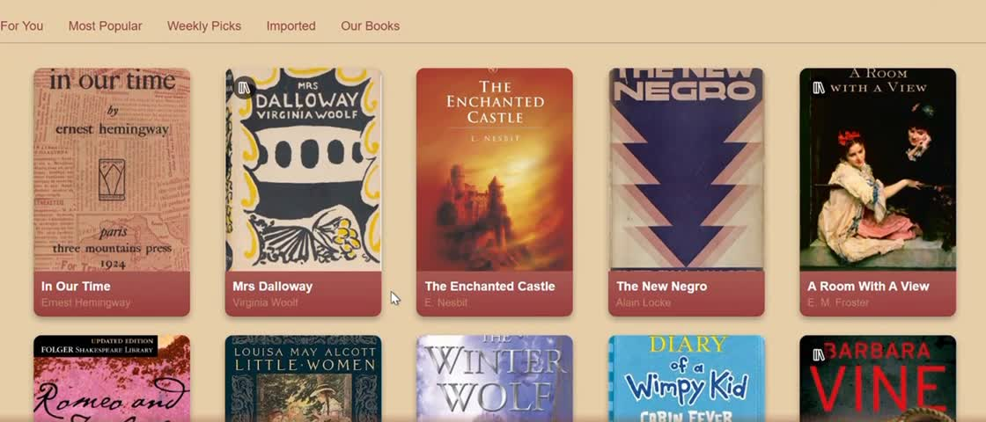

DEMO
website development
lovable.dev
video generation
meta.ai
voice generation
naturalreaders.com

Slide 7

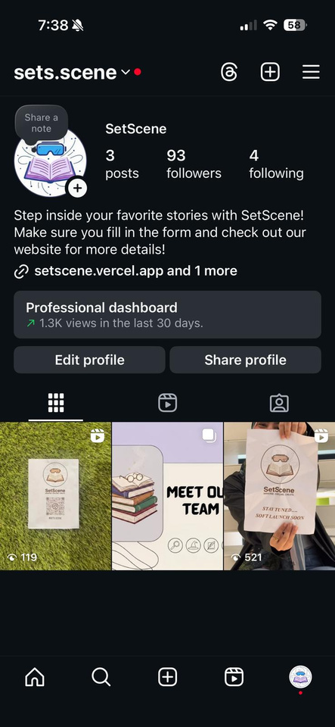
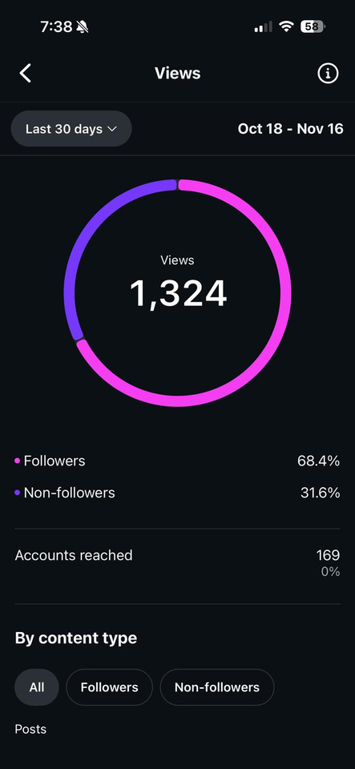
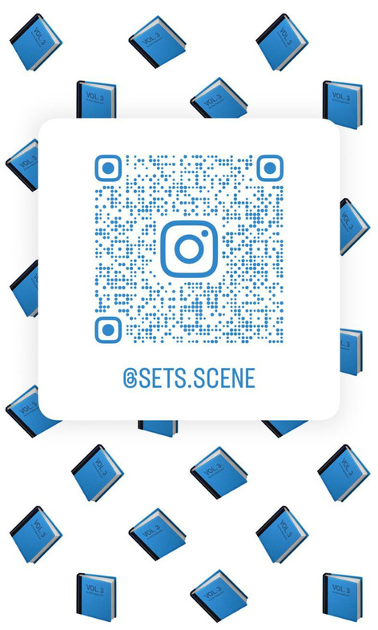

INSTAGRAM

Slide 8
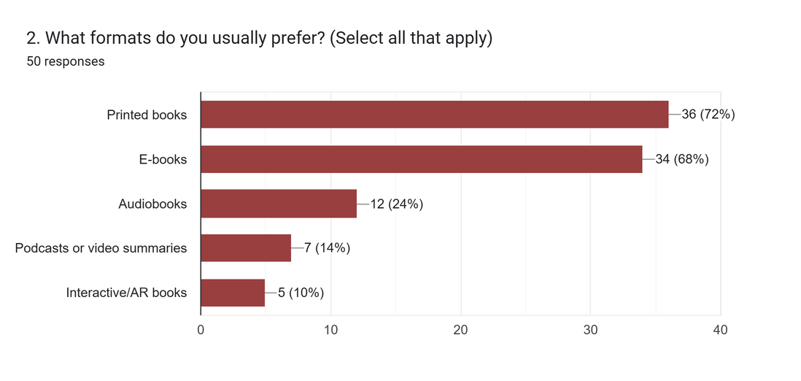
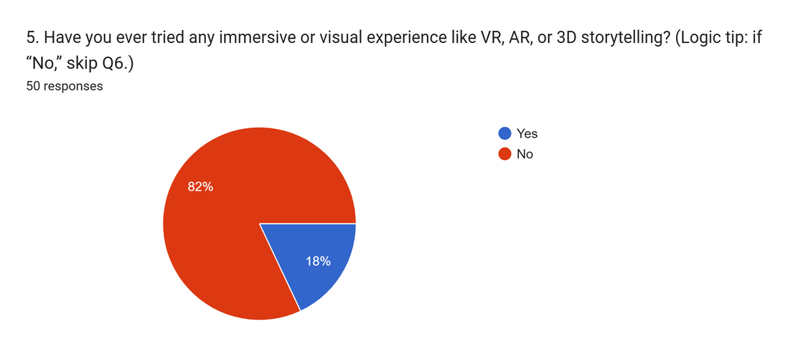
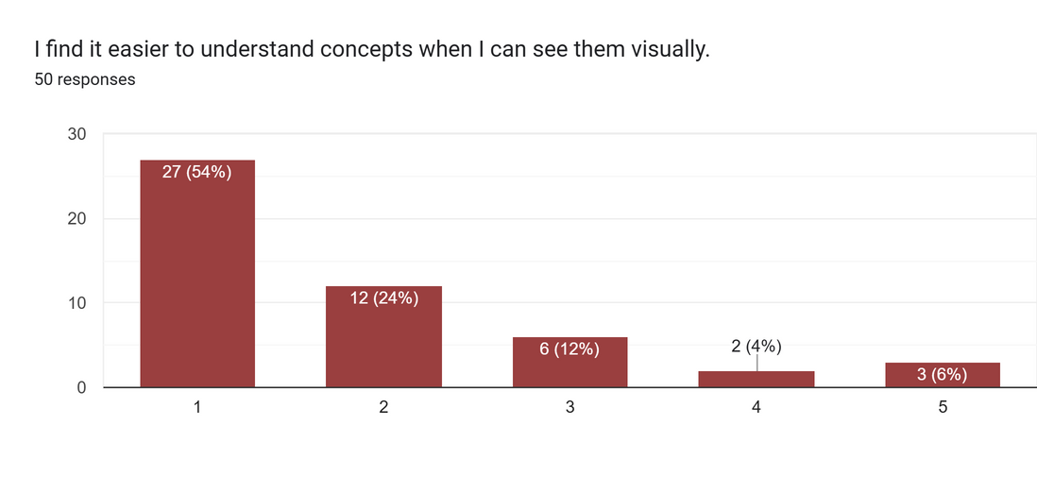
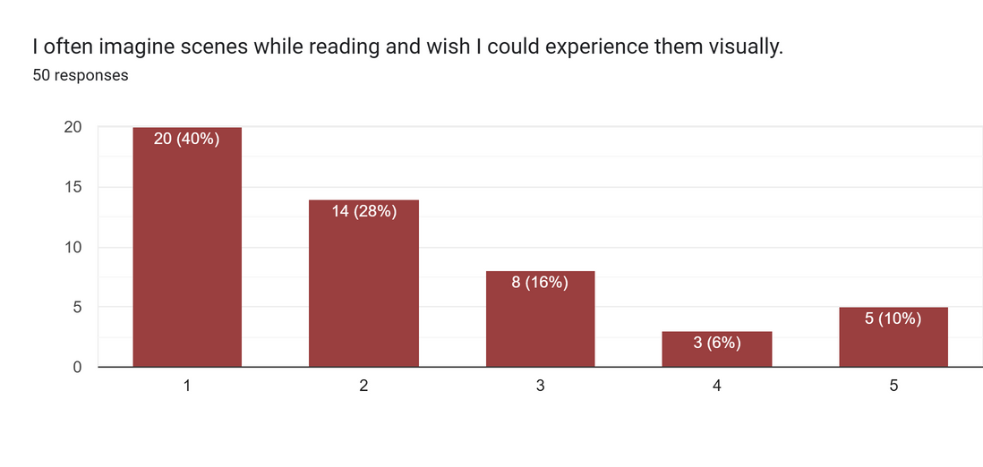
FORM/ SURVEY

Slide 9
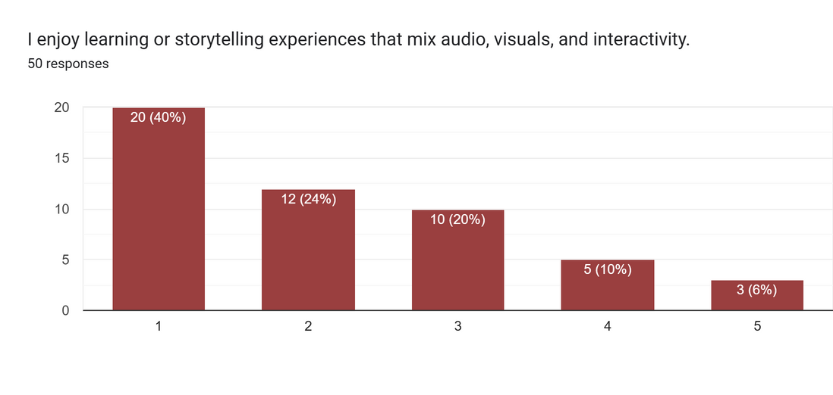
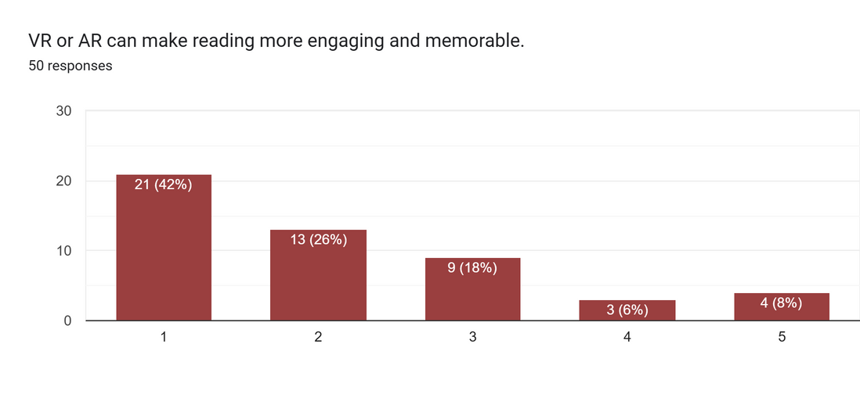
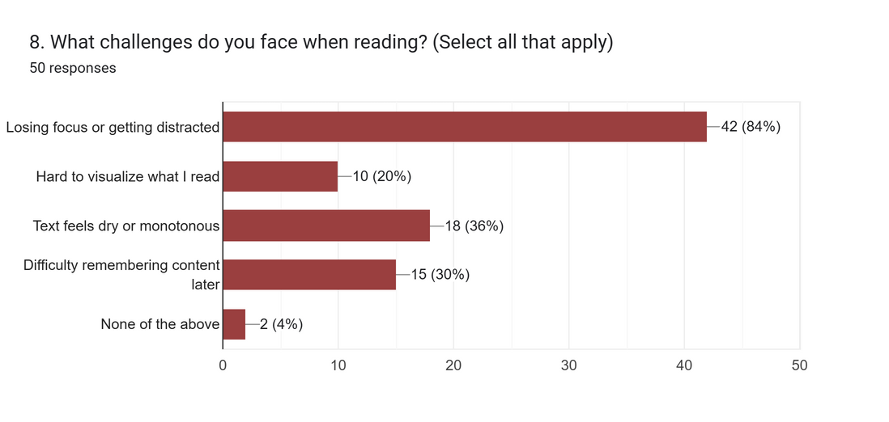
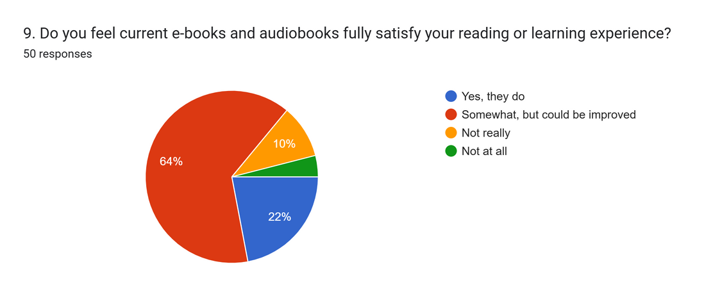
FORM/ SURVEY
cont.

Slide 10
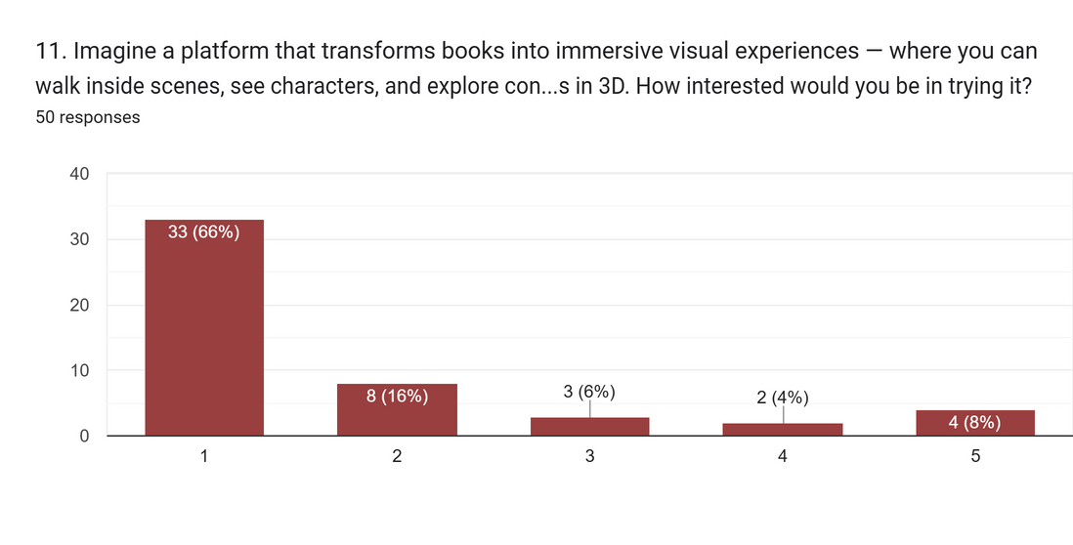
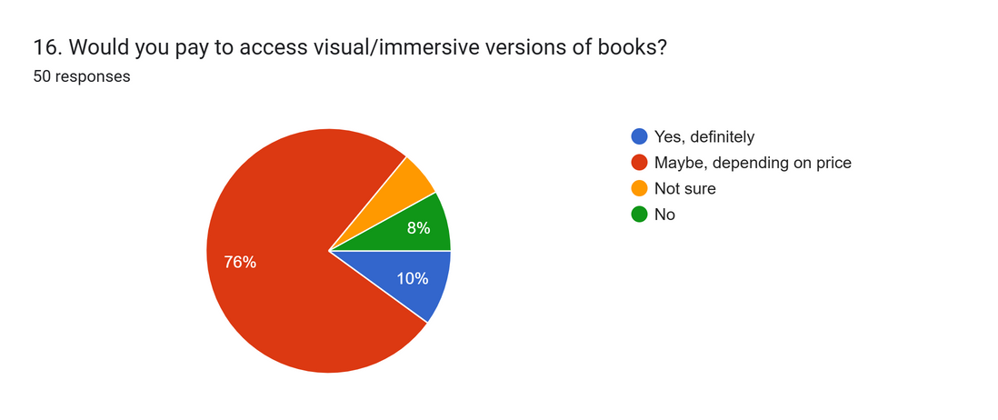
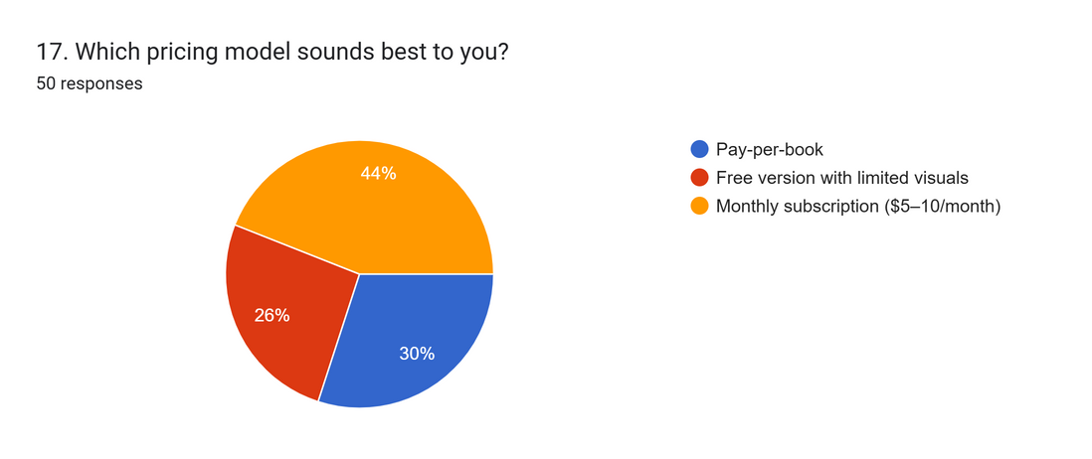
FORM/ SURVEY
cont.

Slide 11
MARKET FEASIBILITY STUDY
Target Market
Readers: students, dyslexic/visual learners, general readers, VR owners
Creators: authors, publishers, visual artists
Clear earlyvangelists with strong need + high willingness to try new formats
Demand Evidence
Survey + landing page show strong interest & willingness to pay
Qatar/MENA: high literacy, rising VR adoption, fast-growing e-learning market
Global trends: immersive learning, digital entertainment, multimedia reading
Competitive Landscape
Direct: Audible, Storytel
Indirect: Netflix, Kindle, YouTube learning
Gap: No VR-first videobook platform in MENA → strong first-mover advantage
Differentiation: VR immersion, AI recommendations, reader–creator ecosystem

Slide 12
MARKET FEASIBILITY STUDY
cont.
Customer Insights
Earlyvangelists: dyslexic readers, students, VR users, authors
Validation tools: landing page MVP, mock sales, Wizard-of-Oz tests, A/B testing, focus groups
Strong evidence of real market need before full development
Regulatory Feasibility (Qatar)
Manageable copyright & publishing licensing
Standard content compliance for minors
Qatar favors tech/creative startups; easy registration via “Startup Qatar”
Financial Feasibility
Revenue: subscriptions, per-book sales, premium tiers, creator revenue share
Costs: VR app development, AI engine, cloud streaming, marketing
Strong funding access: QDB, QSTP, Mada (assistive tech), Tamkeen, MCIT, YEC

Slide 13
MARKET FEASIBILITY STUDY
cont.
Strengths
First VR videobook platform in the region
Multiple revenue streams; high societal impact
Strong alignment with digital learning trends
Weaknesses
VR adoption still growing
Higher initial development + content production costs
Opportunities
Rising VR usage across GCC
No regional competitors
Government support for VR, AI & EdTech innovation
Threats
Global giants could enter later
Cultural or regulatory content restrictions
Overall Feasibility
Market Feasibility = Strong
SetScene is well-positioned for launch in Qatar with high regional expansion potential.

Slide 14

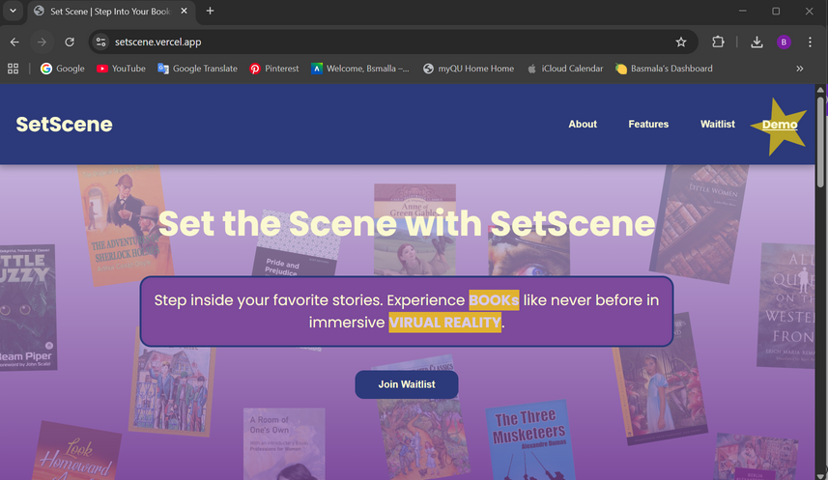
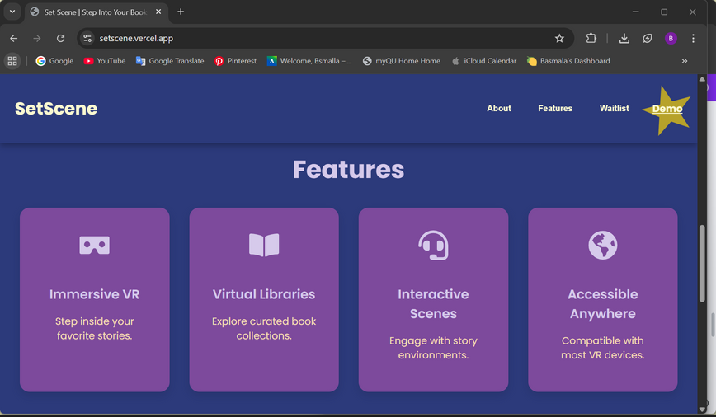

OUR LANDING PAGE
our website

Slide 15
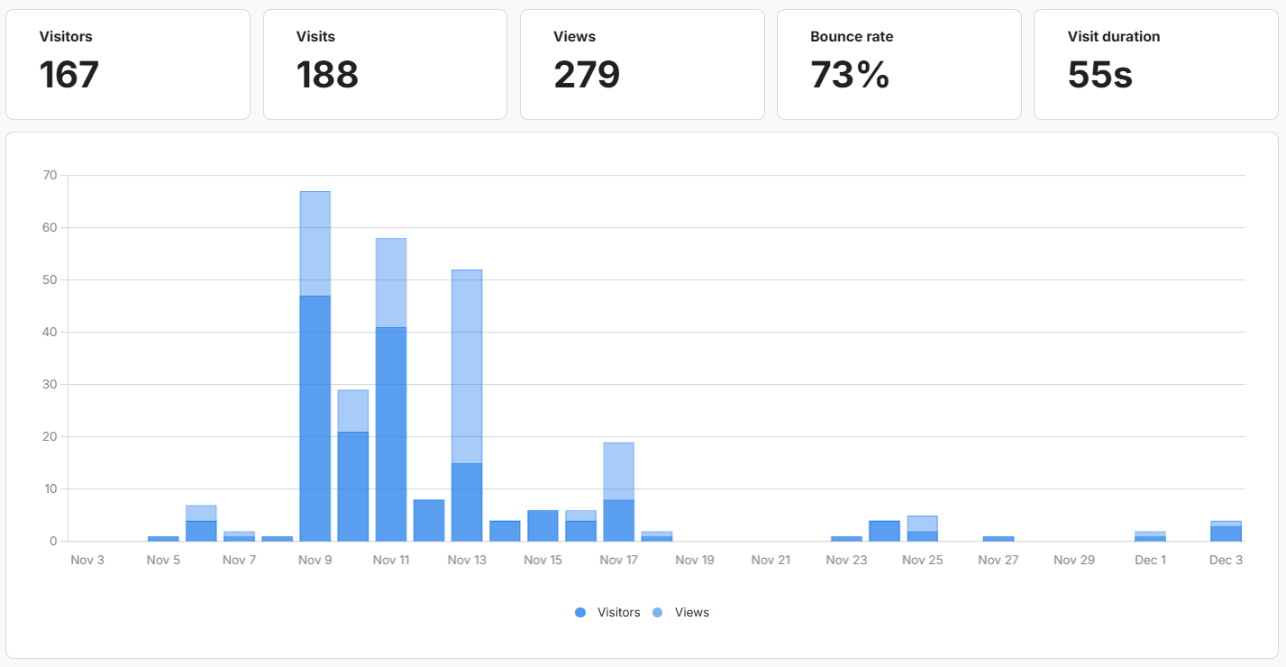
LANDING PAGE INSIGHTS
31 visitors joined the waitlist within a month

Slide 16
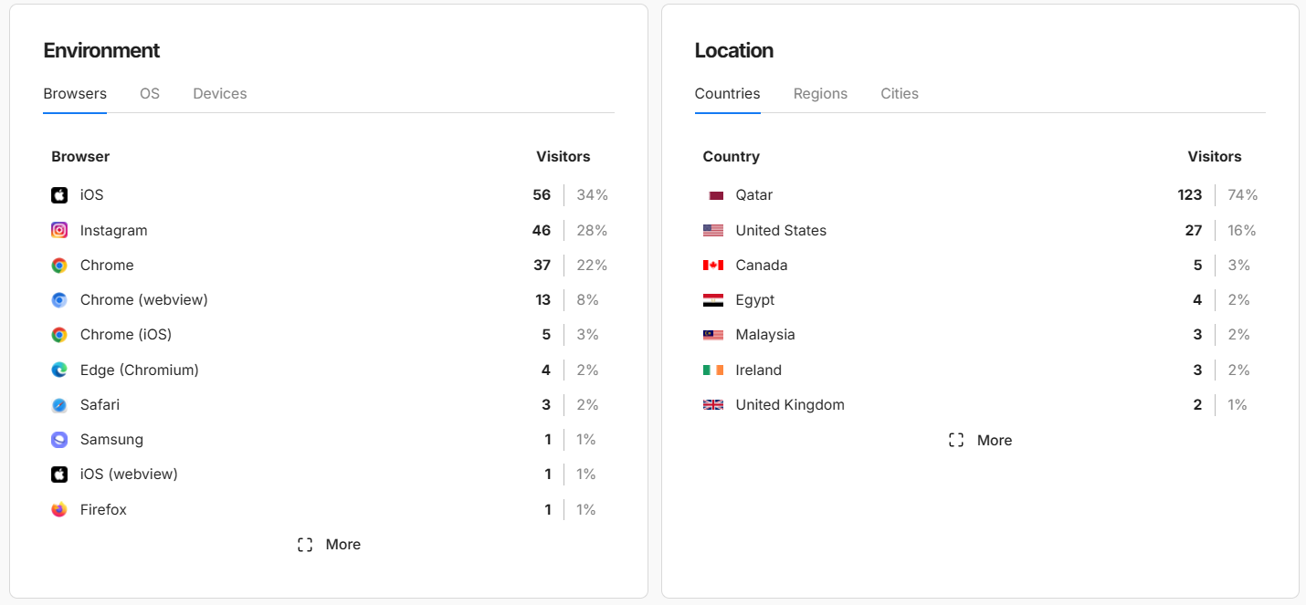
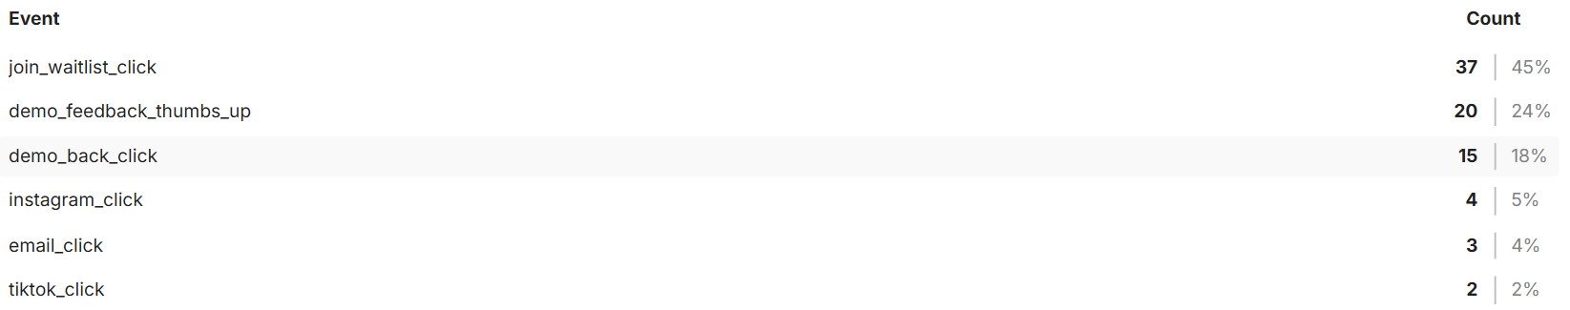
LANDING PAGE INSIGHTS
cont.

Slide 17
TEAM
Bsmalla Mohamed
Social Media Manager & Concept Designer
Oversees Instagram strategy and creates mind-mapping frameworks that shaped the project vision.
Ahya Al Wattar
Content Curator & Market Analyst
Selects book content for the platform, conducts market feasibility studies, and contributes to project structure and scheduling.
Shahad Musa
Prototype Developer & Strategy Analyst
Supports prototype development and prepares the SWOT analysis to guide project direction and strategy.
Aisha Adayaki
User Research Lead & Risk Analyst
Designs user forms, supports financial planning, and analyzes technical and non-technical challenges affecting the project.
Atrab Ali
Prototype Developer & Social Media Coordinator
Works on core prototype features and supports content creation and management on Instagram.
Non Alkhidir
Web Lead & Project Scheduler
Develops the landing page and manages project scheduling and timelines through PERT, in addition to contributing to the financial plan.

Slide 18
THANK YOU!

